Slide 1
Logic: Formal and informal definition.The spheres of its implication.
Minuk Valeriia DA-92

Slide 2
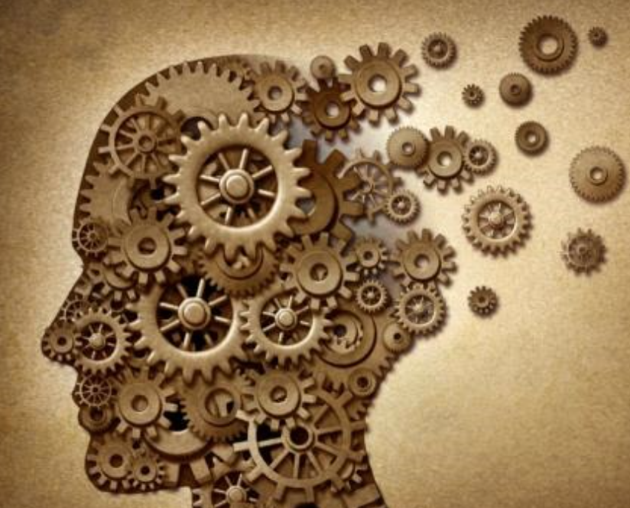
Definition of Logic
Formal
Logic is the systematic study of valid rules of inference, i.e. the relations that lead to the acceptance of one proposition (the conclusion) on the basis of a set of other propositions (premises). More broadly, logic is the analysis and appraisal of arguments.
Informal
In logic, we study the rules and techniques that allow us to distinguish good, correct reasoning from bad, incorrect reasoning.

Slide 3
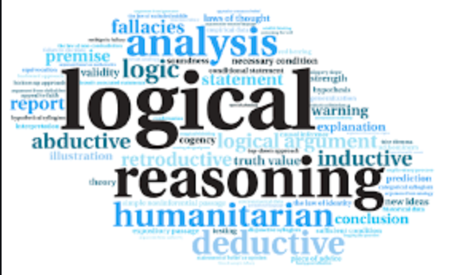
Deep in the water
Since there are a variety of different types of reasoning and methods with which to evaluate each of these types, plus various diverging views on what constitutes correct reasoning, there are many approaches to the logical enterprise. We talk of logic, but also of logics. A logic is just a set of rules and techniques for distinguishing good reasoning from bad. A logic must formulate precise standards for evaluating reasoning and develop methods for applying those standards to particular instances.

Slide 4
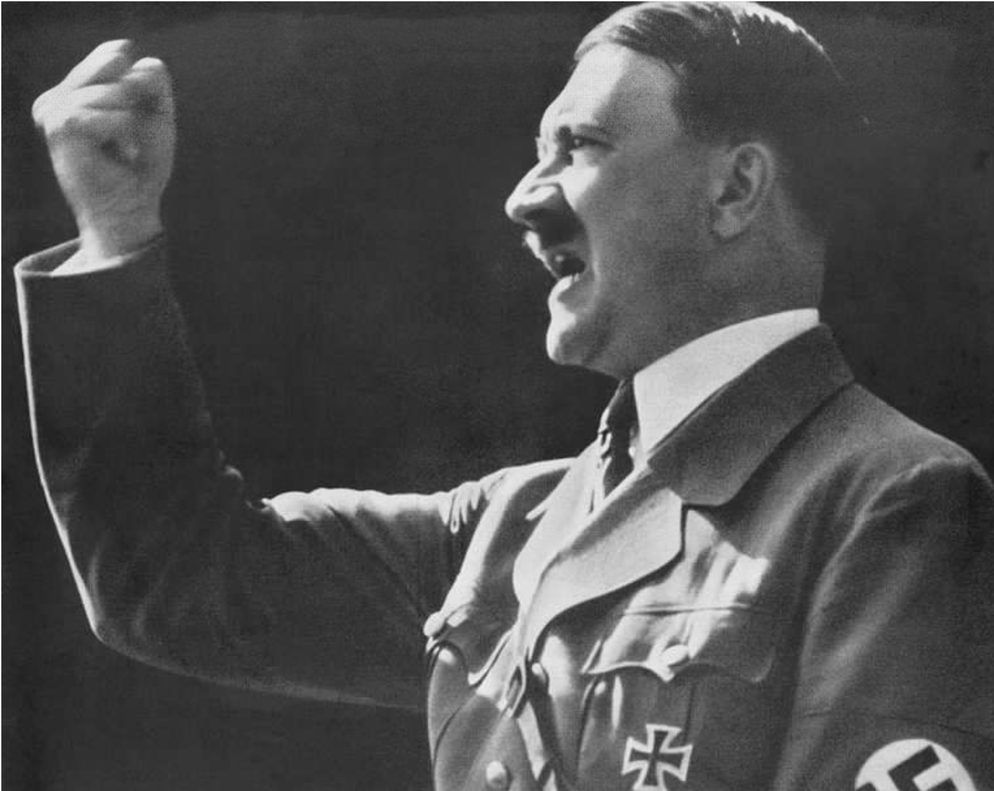
Examples are important
For example,
Consider Hitler. He persuaded an entire nation to go along with a variety of proposals that were not only false but downright evil. You won’t be surprised to hear that if you examine it critically, his reasoning does not pass logical muster. Hitler’s arguments were effective, but not logically correct. Moreover, his persuasive techniques go beyond reasoning in the sense of backing up claims with reasons. Hitler relied on threats, emotional manipulation, unsupported assertions, etc. There are many rhetorical tricks one can use to persuade.

Slide 5
Why do we need logic
First of all logic is important because it influences every decision we make in our lives
I’d like to add some quotes for better understanding:
Logic is the art of going wrong with confidence.
Logic: an instrument used for bolstering a prejudice.
It is always better to say right out what you think without trying to prove anything much: for all our proofs are only variations of our opinions, and the contrary-minded listen neither to one nor the other.
Most of our so-called reasoning consists in finding arguments for going on believing as we already do.
Logic, like whiskey, loses its beneficial effect when taken in too large quantities.
Logic is neither a science nor an art, but a dodge.

Slide 6
Where do we use logic
Mathematical Logic
In mathematical logic, you apply formal logic to math. This type of logic is part of the basis for the logic used in computer sciences. Mathematical logic and symbolic logic are often used interchangeably
Symbolic Logic
Symbolic logic deals with how symbols relate to each other. It assigns symbols to verbal reasoning in order to be able to check the veracity of the statements through a mathematical process. You typically see this type of logic used in calculus.
General Science
Scientists use logic because it shows the relationships between the parts of an idea and the whole idea. Therefore, if you use logic, you can see a relationship between a few trees and the entire forest. ... The scientific method is a rational, logical thought process that is used to figure out facts and truths.

Slide 7
And some examples
The study of language
One general reflection of the influence of logical semantics on the study of linguistic semantics is that logical symbolism is now widely assumed to be the appropriate framework for the semantical representation of natural language sentences.
Epistemic logic
The application of logical techniques to the study of knowledge or knowledge claims is called epistemic logic. The field encompasses epistemological concepts such as knowledge, belief, memory, information, and perception. It also turns out that a logic of questions and answers, sometimes called “erotetic” logic (after the ancient Greek term meaning “question”), can be developed as a branch of epistemic logic.
Logic of questions and answers
The logic of questions and answers, also known as erotetic logic, can be approached in different ways. The most general approach treats it as a branch of epistemic logic.
Inductive logic
Inductive reasoning means reasoning from known particular instances to other instances and to generalizations. These two types of reasoning belong together because the principles governing one normally determine the principles governing the other.
Belief revision
One area of application of logic and logical techniques is the theory of belief revision. It is comparable to epistemic logic in that it is calculated to serve the purposes of both epistemology and artificial intelligence. Furthermore, this theory is related to the decision-theoretical studies of rational choice.

Slide 8
Thank you for attention

